Slide 1
Lesson 1
The Outline of the Book of Judges
A, Reasons for Israel’s Oppression (Chs. 1 – 2)
The incomplete conquest
B, Deliverance from Oppressors (Chs. 3 – 8)
Moab, Canaan, and Midian
C, Abimelech the Non-Judge (Ch. 9)
Contrasted with true judges
B¹, Deliverance from Oppressors (Chs. 10 – 16)
Ammon and Philistia
A¹, Reasons for Israel’s Oppression (Chs. 17 – 21)
Idolatry, immorality, and in-fighting

Slide 2
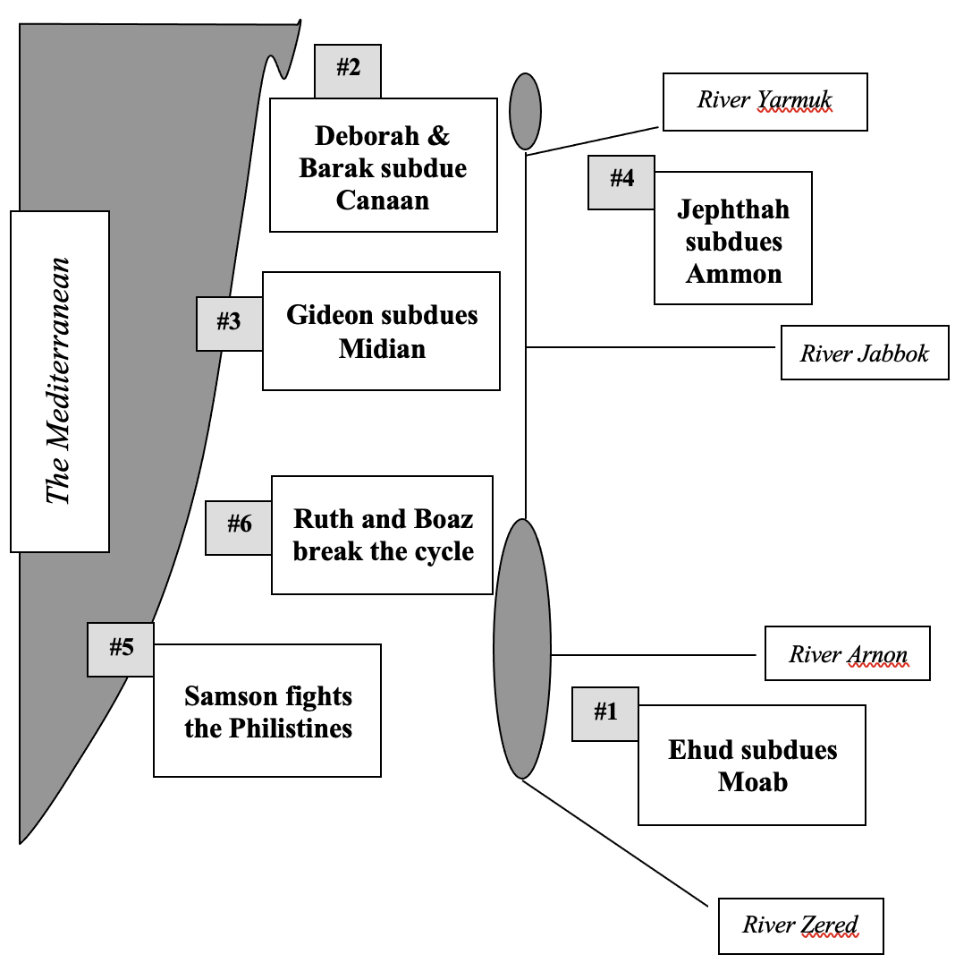
Lesson 1
B
Gali-lee
Jordan
River
A
Dead
C

Slide 3
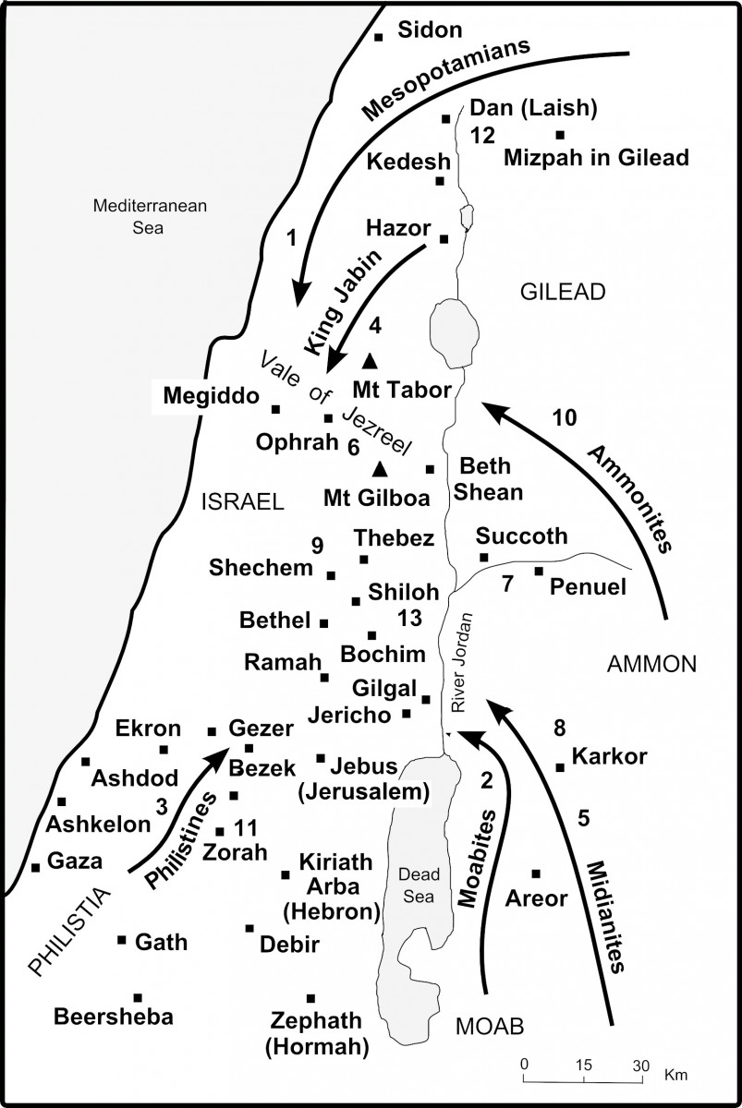
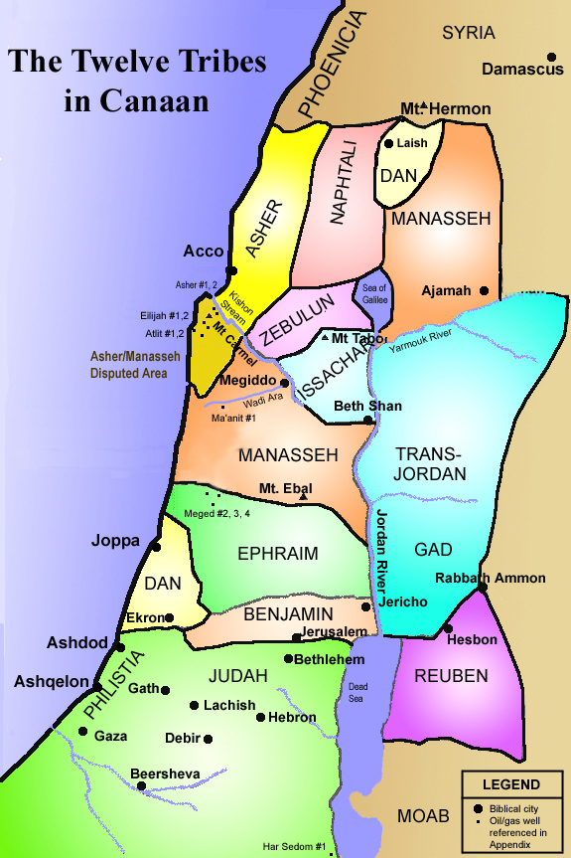
https://www.thebiblejourney.org/biblejourney2/28-the-israelites-face-continuing-opposition/the-israelites-fight-the-remaining-canaanites/

Slide 4
Simon Jenkins, Nelson’s 3-D Bible mapbook [computer file], electronic ed., Logos Library System, (Nashville: Thomas Nelson) 1997, © 1985 by Lion Publishing.

Slide 5
Lesson 1
The Occupation of Canaan: Failed, or Delayed?
1. Israel was too few in number (Deut. 7:22)
Yahweh your God will clear away these nations before you little by little; you will not be able to put an end to them quickly, lest the wild beasts become too numerous for you.
2. Inferior military power (Judges 1:19)
The inhabitants of the valley … had iron chariots
3. Teaching a new generation to know war (Judges 3:2)
…in order that the generations of the sons of Israel would know war, by learning war, especially those who had not known it formerly

Slide 6
Lesson 1
The Occupation of Canaan: Failed, or Delayed?
4. Covenants with the Canaanites (Judges 2:1-5)
You shall cut no covenant with the inhabitants of this land; you shall tear down their altars. But you have not listened.
5. God’s punishment (Judges 2:20-21)
Because this nation has trespassed against My covenant which I commanded … and has not listened to My voice, ²¹ I also will no longer dispossess before them any of the nations which Joshua left….
6. God’s test of their faithfulness (Judges 2:22-23)
…in order to test Israel by them, whether they will keep the way of Yahweh to walk in it as their fathers did, or not.” ²³ So Yahweh allowed those nations to rest, not dispossessing them quickly;

Slide 7
Lesson 2
The Cycle of the Book of Judges
Apostasy
Oppression
Cry for help
Peace
Deliverance

Slide 8

Lesson 2
The Cycle of the Book of Judges
Apos-tasy
Oppres-sion
Cry for help
Deliver-ance
Peace

Slide 9
Multiple Lessons
The Table of the Judges
Judge’s Name | Tribe | Oppressor | Years of Oppression | Years of Rest/ Judge’s Rule
1. Othniel | Judah (nephew of Caleb, Num. 13:6) | Cushan-Rishathaim king of Mesopotamia | 8 | 40
2. Ehud | Benjamin | Eglon king of Moab | 18 | 80
3. Shamgar | ? | Philistines | ? | ?
4. Deborah/Barak | Ephraim (her location) Naphtali (his town) | Jabin king of Canaan | 20 | 40
5. Gideon | Manasseh | Midian | 7 | 40
6. Tola | Issachar (but dwelt in the mts. of Ephraim) | ? | ? | 23
7. Jair | “Gileadite” (which incl. Gad, Reuben, and S. Manasseh) | ? | ? | 22
8. Jephthah | “Gileadite” (see above) | Philistines and Ammonites | 18 | 6
9. Ibzan | of Bethlehem | ? | ? | 7
10. Elon | Zebulun | ? | ? | 10
11. Abdon | Ephraim (town, Pirathon)* | ? | ? | 8
12. Samson | Dan | Philistines | 40 | 20

Slide 10
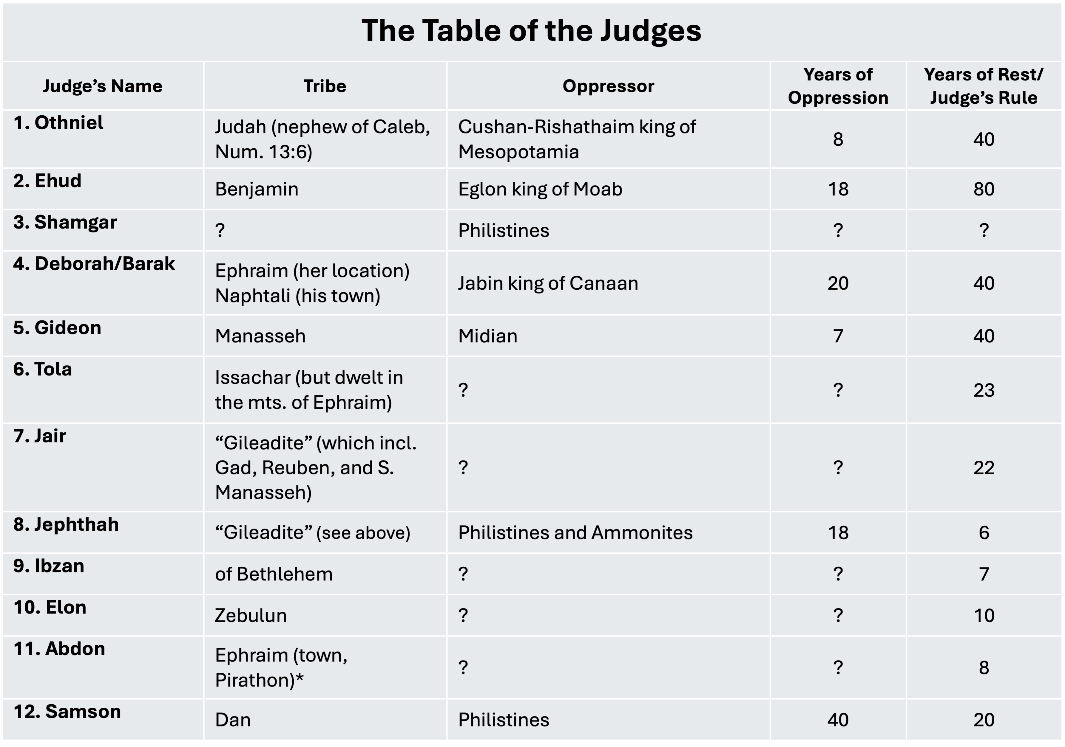

Slide 12
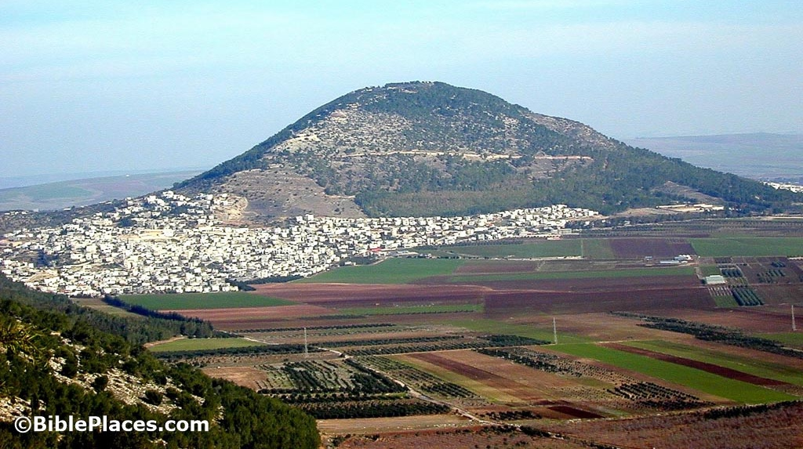
Lesson 3
Mt. Tabor, by the Jezreel Valley,
through which flows the Kishon River

Slide 13
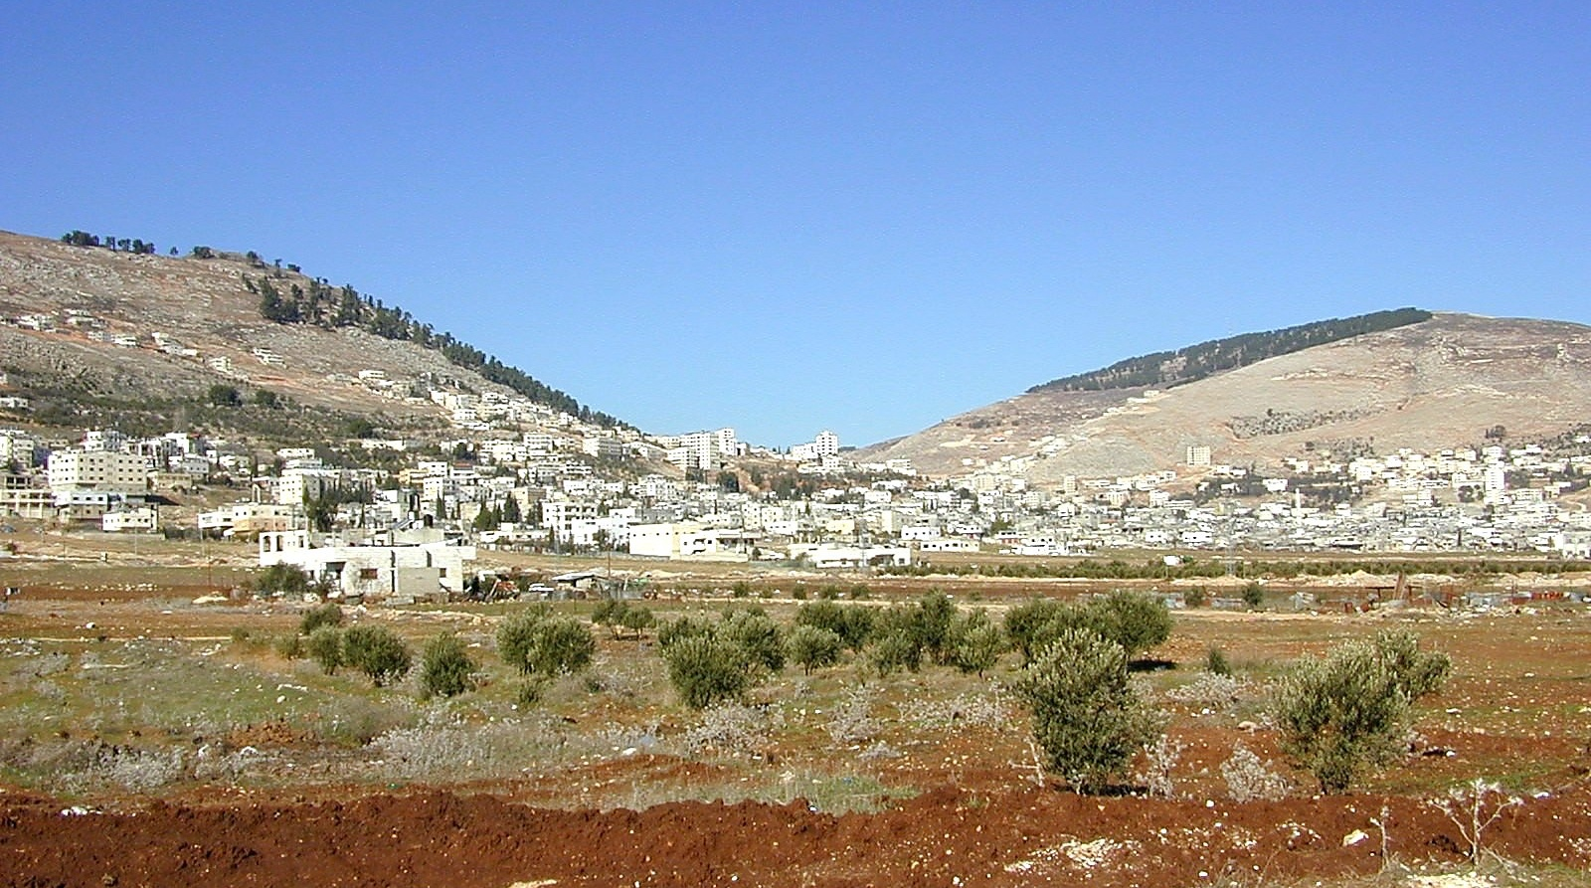
Lesson 5
Mt. Gerizim (left) and Mt. Ebal,
with modern Nablus in between
https://medomed.org/wp-content/uploads/2017/06/MOUNT-GERIZIM-Palestine.jpg

Slide 14
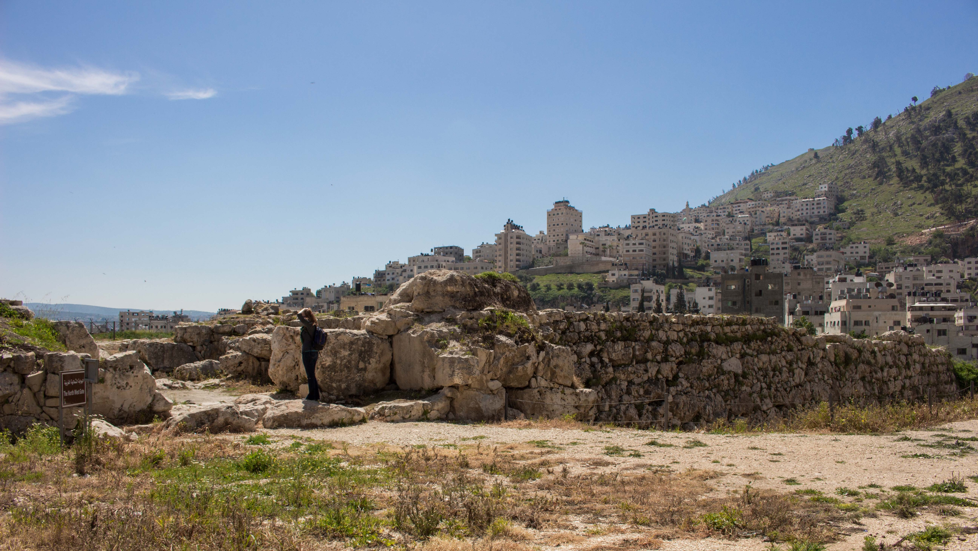
Lesson 5
Tel-Balata, the ruins of Shechem,
just outside modern Nablus
https://upload.wikimedia.org/wikipedia/commons/7/71/Tell_Balata.jpg

Slide 15
Lesson 6
5. Gideon | Manasseh | Midian | 7 | 40
6. Tola | Issachar (but dwelt in the mts. of Ephraim) | ? | ? | 23
7. Jair | “Gileadite” (which incl. Gad, Reuben, and S. Manasseh) | ? | ? | 22
8. Jephthah | “Gileadite” (see above) | Philistines and Ammonites | 18 | 6
9. Ibzan | of Bethlehem | ? | ? | 7
10. Elon | Zebulun | ? | ? | 10
11. Abdon | Ephraim (town, Pirathon)* | ? | ? | 8

Slide 16
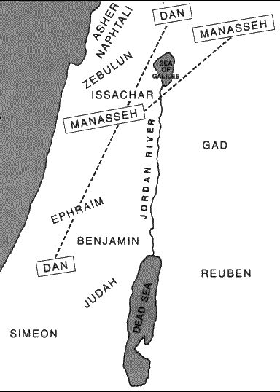
Lesson 9
Dan’s move
City of Laish,
a.k.a., Leshem (Josh. 19:47),
a.k.a., Dan
General Area of the 12 Tribes: Thomas Nelson, Inc., Nelson’s complete book of Bible maps and charts: Old and New Testament [computer file], electronic ed., Logos Library System, (Nashville: Thomas Nelson) 1997, c1996.

Slide 17
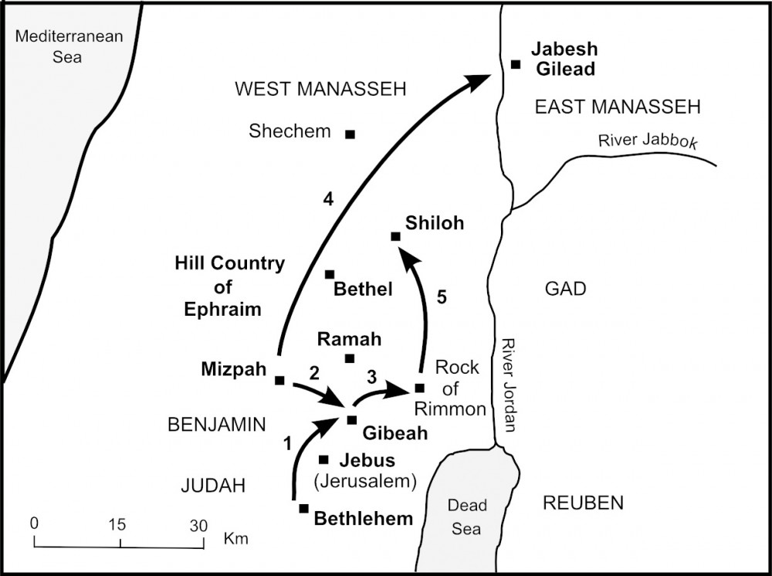
Lesson 10
Civil War over Gibeah & the Destruction of Jabesh Gilead
https://www.thebiblejourney.org/biblejourney2/28-the-israelites-face-continuing-opposition/gibeon-is-destroyed-and-the-benjamites-punished/

Slide 18
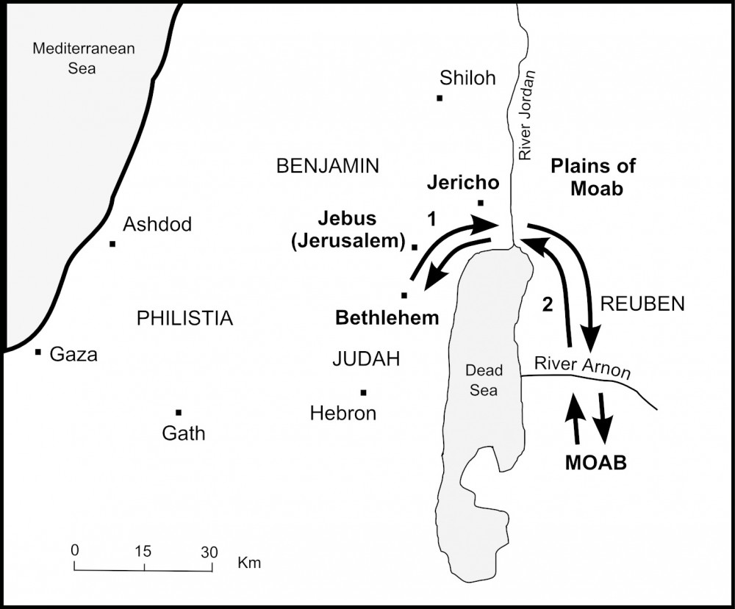
Lesson 11
Ruth’s route
https://www.thebiblejourney.org/biblejourney2/29-the-journeys-of-ruth-and-samuel/ruths-journey-to-bethlehem/

